Slide 1

Deep Learning for Medical Image Classification
Normal vs. Pneumonia Chest X-rays
UP2225522

Slide 2
Introduction
Aims
Develop CNN model for chest X-ray classification (Normal vs. Pneumonia)
Utilise transfer learning with pre-trained CNN architectures
Add SVM & Random Forest on top of CNN for classification
Evaluate the performance of combined models using appropriate metrics
Compare performance with standalone CNN model to assess improvement

Slide 3
Background
Computer-aided Medical Imaging in Diagnosis & Role of Deep Learning :
Successful computer-aided disease diagnosis or prognosis (Shen et al., 2017)
Deep learning models such as CNN are widely employed in real-time medical image analysis to enhance patient outcomes (Li et al., 2023)
Objective: This project aims to use deep learning techniques, including CNN & transfer learning, and integrate them with SVM and Random Forest classifiers to develop an accurate and efficient model for classifying chest X-ray images into two categories: normal and pneumonia

Slide 4
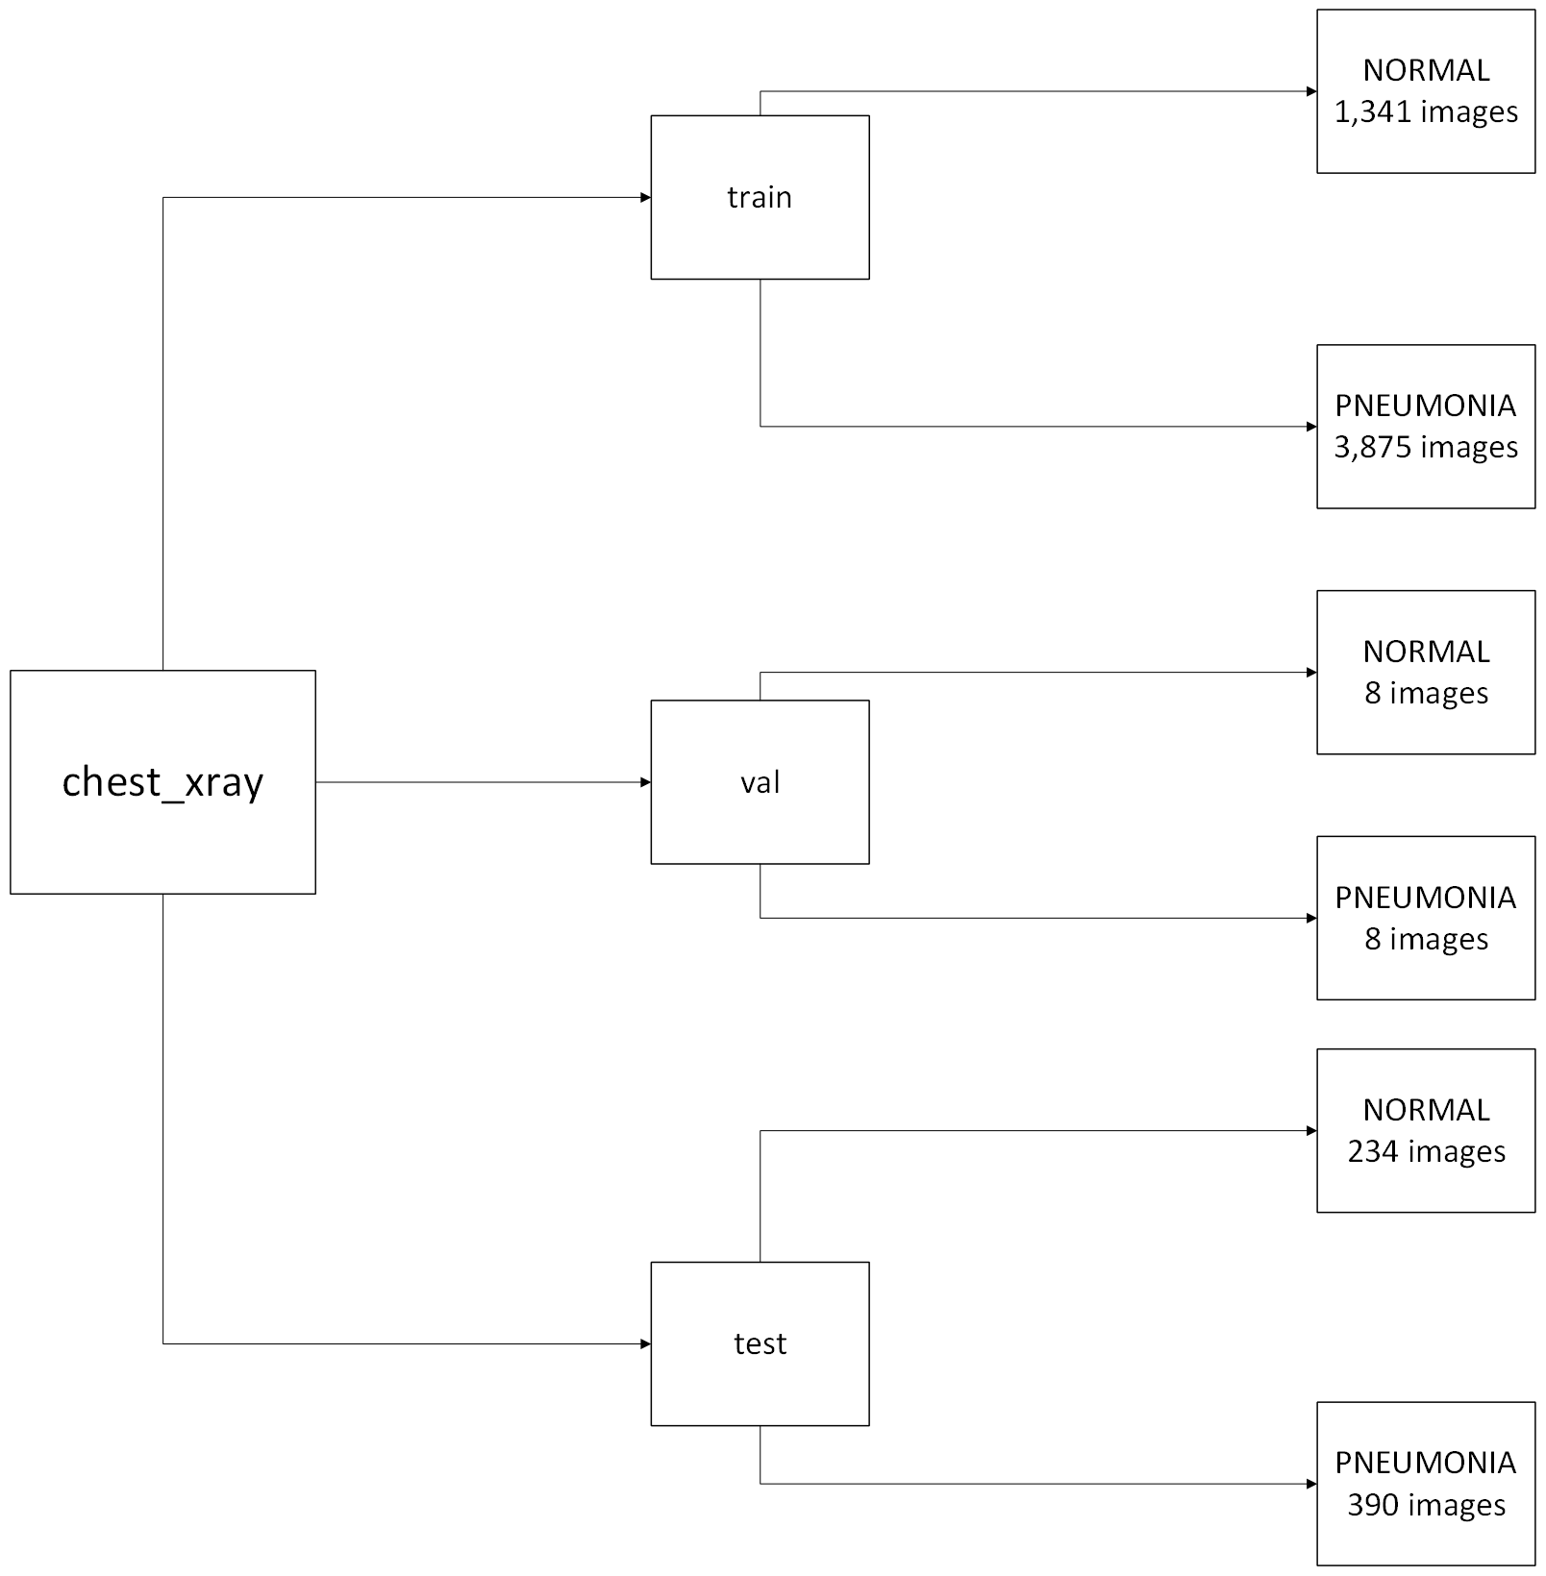
Dataset
From Kaggle, Chest X-Ray Images (Pneumonia) (MOONEY, 2018)

Slide 5
Methodology
Pre-processing: Clean and preprocess the dataset to ensure uniformity and quality, including resizing, normalisation, and augmentation techniques.
Model Development: Design and implement CNN architectures for medical image classification tasks.
Training and Evaluation: Train the model on the preprocessed dataset and evaluate its performance using the accuracy score
Implement Transfer Learning: Implement SVM & Random Forest on top of the pre-trained CNN and evaluate the performance

Slide 6
Pre-Processing
A function process_data(img_dim, batch_size) is created
This function sets up data generators for training and testing for evaluation. It ensures that the image data is properly processed and ready for training and testing.

Slide 7
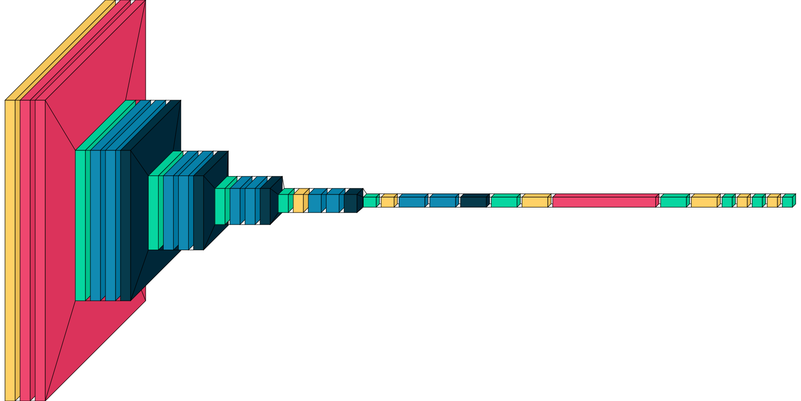
Model Development
Generated by Visualkeras Library
Generated by netron Library

Slide 8
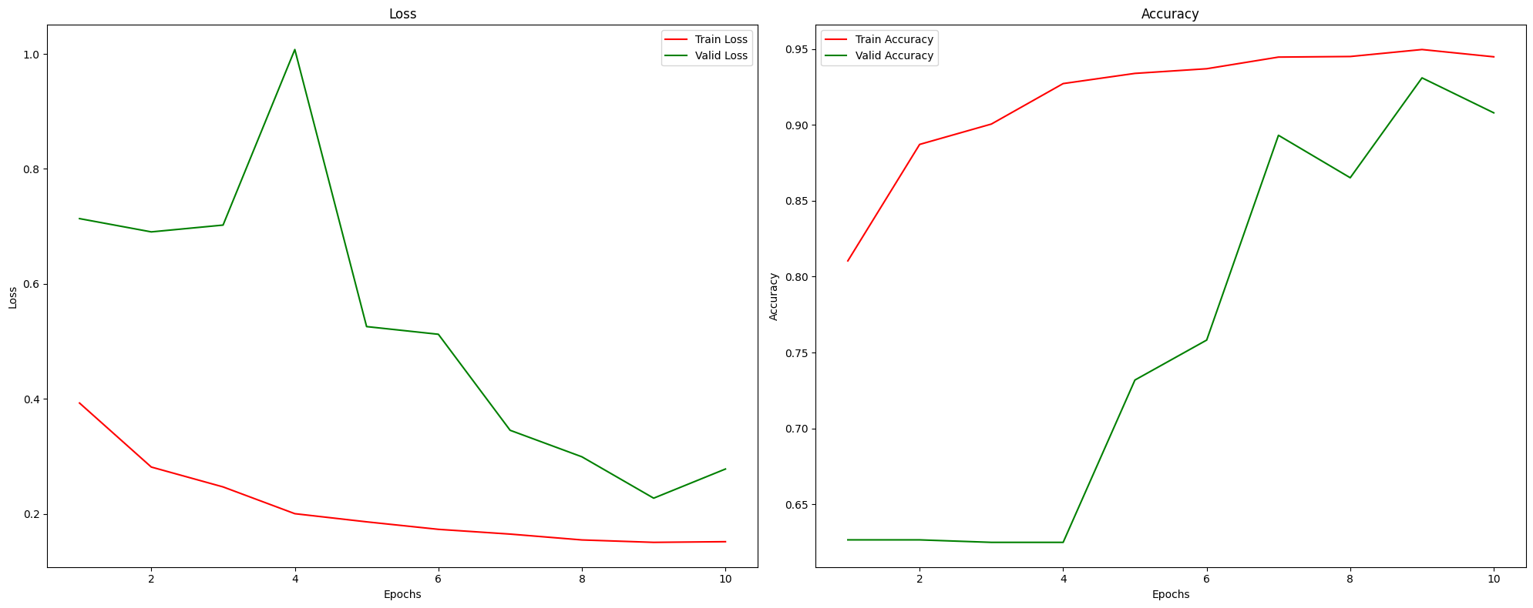
CNN Training & Evaluation
The model is then complied with optimizer = 'adam' , loss = 'binary_crossentropy' , metrics= ['accuracy’]
Then trained & validated with 10 epochs (best weights saved and learning rate adjusted)
Accuracy: 90.87%

Slide 9
Implement Transfer Learning
Trained & test features are then extracted from the Pre-trained CNN
SVM & Random Forest are then implemented
SVM Accuracy: 90.87%
Random Forest Accuracy: 85.74%

Slide 10
Results & Disscussion
CNN Accuracy: 90.87%
SVM Accuracy: 90.87%
Random Forest Accuracy: 85.74%
CNN & SVM performs the best
Random Forest sees a drop in accuracy
Transfer Learning is not necessary

Slide 11
Limitations
Computational Limitation
Low validation image set
Poor implementation of Transfer Learning

Slide 12
Conclusion
Successfully built and deployed CNN for Medical Image Classification
CNN is overall the best-performing model
Future work:
Use parallel processing for training
Find a data set with larger validation image sets
Deploy a more robust transfer learning model

Slide 13

Reference
MOONEY, P. (2018). Chest X-Ray Images (Pneumonia). Www.kaggle.com. https://www.kaggle.com/datasets/paultimothymooney/chest-xray-pneumonia
‌
Li, M., Jiang, Y., Zhang, Y., & Zhu, H. (2023). Medical image analysis using deep learning algorithms. Frontiers in Public Health, 11. https://www.ncbi.nlm.nih.gov/pmc/articles/PMC5479722/
Shen, D., Wu, G., & Suk, H.-I. (2017). Deep Learning in Medical Image Analysis. Annual Review of Biomedical Engineering, 19(1), 221–248. https://www.ncbi.nlm.nih.gov/pmc/articles/PMC5479722/

